Slide 1















Restaurant Management System

Slide 2

Presented By
Saifulla Tanim (ID: 222002014)
Mim Akter (ID: 222002104)
Teacher by:
Mr. Mozdaher Abdul Quader
Lecturer
Green University of Bangladesh

Slide 3

CONTENTS
Introduction
Objectives
Implementation Interface
Features
Challenges
Conclusion
Future Scope

Slide 4
Introduction
The Restaurant Management System automates restaurant operations. This technology simplifies restaurant management by letting users browse menu categories, choose goods, and compute charges. Small businesses who want to digitise without expensive gear will find it handy.

Slide 5
To automate the process of order-taking and billing.
01.
To enhance customer experience through a well-organised menu system.
Objectives
02.
To create a user-friendly interface for both customers and staff.
03.

Slide 6

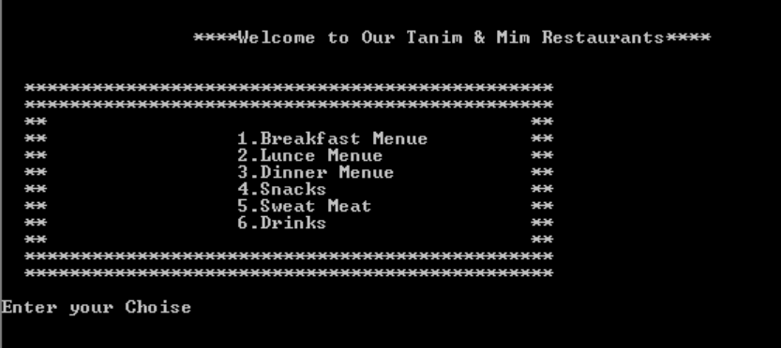
Implementation interface

Slide 7

Features
Interactive Menu Display
Order Management
Error Handling
Simple Navigation

Slide 8
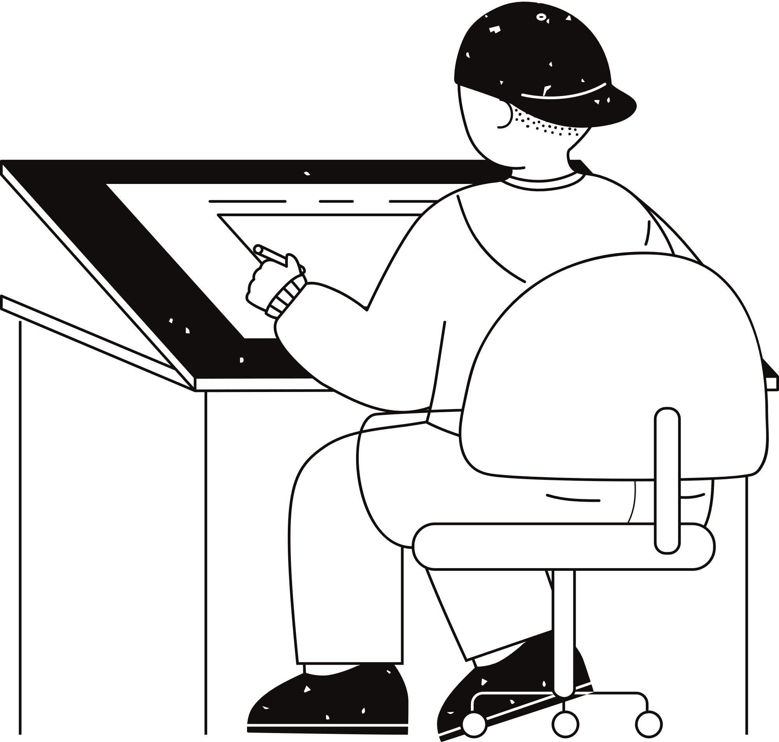



Memory Management:
Handling large datasets within the memory constraints of assembly language.
Error Handling
Debugging:
Ensuring invalid inputs do not crash the system and are appropriately redirected.
Challenges
Identifying and resolving logical errors due to the complexity of assembly language coding.
User Interface:
Designing a user-friendly and visually appealing layout within the constraints of text-based systems.

Slide 9

Future Scop
Quotation
1. Graphical User Interface (GUI)
2. Integration with Payment Systems
3. Database Integration
4. Multilingual Support
5. Mobile and Web Extensions

Slide 10
Conclusion
This project demonstrates the potential of assembly language in developing practical and efficient systems. Despite the challenges of low-level programming, the Restaurant Management System achieves its goals of automation and customer satisfaction.

Slide 11
Thank you very much!

